Slide 1
Linguistics 201
Phonetics 1: Introduction
Francisco Torreira

Slide 2
Topics today
Phonetics
Study of speech sounds
Speech segmentation
Speech Production
The vocal tract
The larynx and glottal states

Slide 3
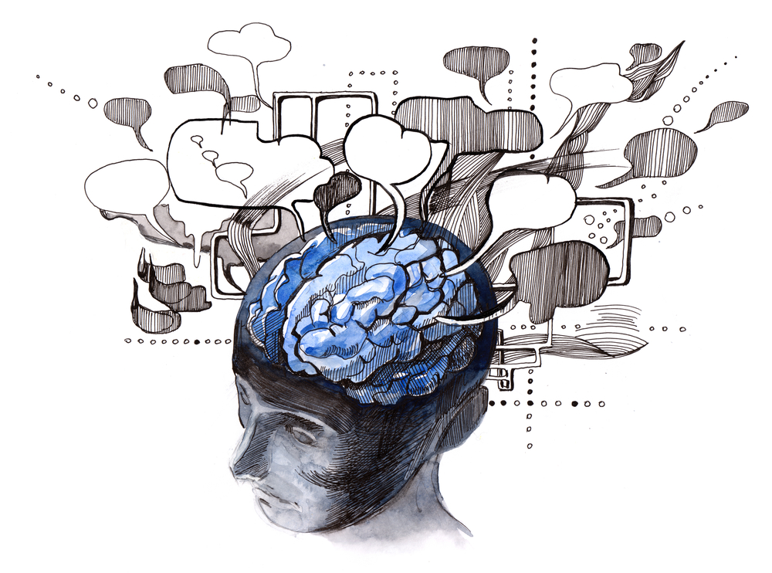
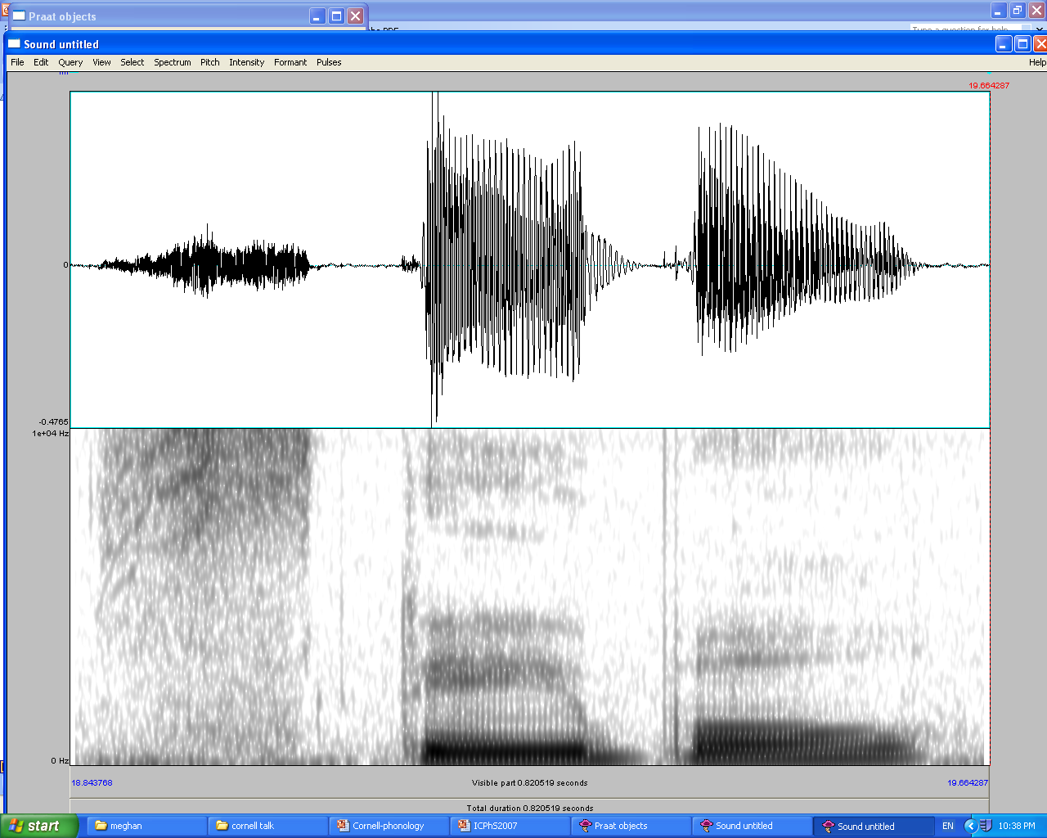
What are speech sounds?
Articulatory process
Perceptual process
Acoustic process
Airstream mechanisms + phonation + articulation
Vibration of air molecules at different frequencies and amplitudes
Auditory processing
Mental categorization

Slide 4
Speech segmentation
Phonetic signals are continuous (i.e. reflect gradient movements of articulators):
Linguists posit that these continuous signals nevertheless carry information about sequences of discrete speech units, which we call segments or speech sounds i.e. vowels and consonants
See O&A section 2.1

Slide 5
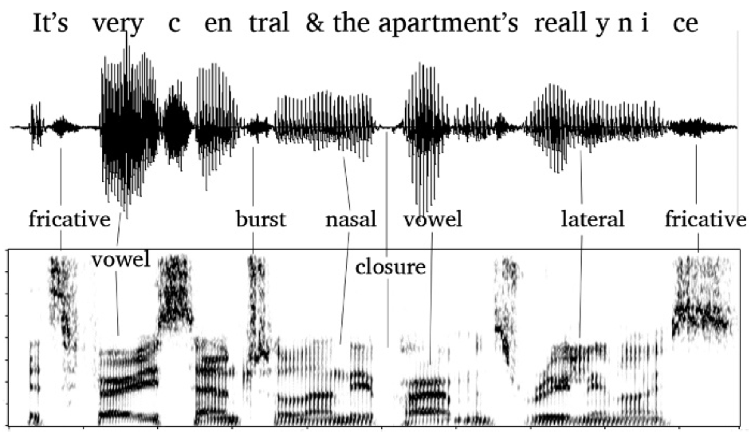

Speech segmentation

Slide 6
Speech segmentation
Amplitude
>> Time >>

Slide 7
Speech segmentation
Amplitude
Frequency
>> Time >>

Slide 8
Speech segmentation
Amplitude
vowel
ɪ t s v ɛ ɹ i s ɛ ntɹ l̩ æn ðiə p^{h} ɑɹtmənts ɹ i l i n aj s
Frequency
>> Time >>

Slide 9
Segmenting speech into sounds
Letters versus sounds:
bit | 3
bet | 3
bat | 3
bought | 6
bite | 4
knight | 6
play | 4

Slide 10
Segmenting speech into sounds
Letters versus sounds:
# letters in each word
bit | 3 | [bɪt]
bet | 3 | [bɛt]
bat | 3 | [bæt]
bought | 6 | [bot]
bite | 4 | [bajt]
knight | 6 | [najt]
play | 4 | [plej]
Each word consists of three sounds (2 consonants, 1 vowel)
Sounds written using IPA symbols
* Note: a͡j , e͡j each = one sound

Slide 11
Segmenting speech into sounds
Many ways to spell the same sound:
Word | Letters | IPA
car | c
kin | k
lick | ck | [k]
monarch | ch
quote | qu

Slide 12
Segmenting speech into letters and sounds
Many sounds for the same spelling:
Word | Letters | IPA
put |  | [ʊ]
but | u | [ʌ]
chute |  | [u]
U-Haul |  | [ju]

Slide 13
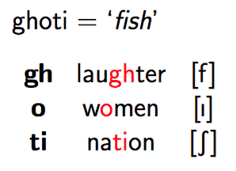
Segmenting speech into letters and sounds
Letters are not good tools for representing how words are pronounced:
For any language (English just particularly bad)
Need an alphabet designed for representing pronunciation
Notes:
Linguistics primarily interested in spoken language. Many languages not written, but languages.
More than 50% could read and write only in 60/70s.
Phonetics interested in sounds, so we have to learn to separate sounds from how words are spelled -- especially in English, where the spelling/sound relationship is very indirect.
Why is English spelling so different from pronunciation? Sound change, borrowings, other factors

Slide 14

International Phonetic Alphabet
One symbol for every sound used distinctively in at least one human language
Used for phonetic transcription
Ideally, could represent pronunciation of word/phrase/utterance in any language
In reality there are (small) cross-linguistic differences among sounds transcribed with the same IPA symbol e.g. [p] in French and Spanish (see Torreira & Ernestus, 2016)
IPA Chart: https://www.internationalphoneticassociation.org/sites/default/files/IPA_Kiel_2015.pdf

Slide 15
We’ll discuss consonants and vowels from the IPA chart in the next two lectures.
We first need the basics of speech production

Slide 16
Speech production
Air supply sets air in motion (e.g. lungs)
A sound source (e.g. larynx), modulates airflow via vocal folds
Filters modify the sound:
Pharynx, oral cavity, nasal cavity
Together called vocal tract
See O&A section 2.2

Slide 17
Airstream mechanisms
Usually speech produced as air expelled from lungs, up the trachea (a.k.a. windpipe)
egressive airflow
Can also produce while inhaling, but rare
ingressive airflow
Ex: ‘yes’, ‘no’ in some dialects of Nordic languages

Slide 18
The larynx
Complex structure of cartilage, muscles, and tissue where vocal folds are located
Vocal folds pulled apart or together
Air passes through glottis
Space between vocal folds
you won’t be tested on these figures

Slide 19
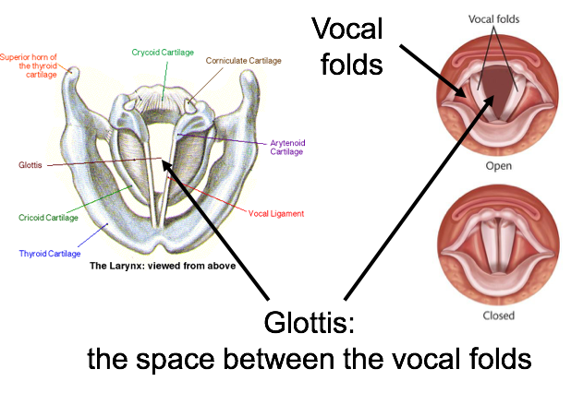
Larynx: viewed from above
http://instruct.uwo.ca/music/999/larynx.html
http://www.phonetics.ucla.edu/vowels/chapter2/vibrating%20cords/vibrating.html

Slide 20
Glottal states
Positioning of vocal folds ⇒ different glottal states
Some common glottal states:
voiceless
(modal) voiced
breathy (voiced)
creaky
Vocal folds during singing:
https://www.youtube.com/watch?v=fPMEA-pV2q8

Slide 21
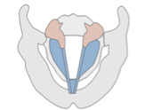
Voiceless
Vocal folds pulled apart
⇒ no vibration of VFs
Sounds produced with this GS: voiceless
Ex: [s], [f], [h]
Put your finger on larynx while saying “sssshhhhh” (etc.)
no vibration

Slide 22
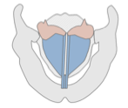
Voiced
Vocal folds are brought together and air is passed through the glottis they open and close
⇒ phonation, or voicing
This GS used for voiced sounds
Ex: [z], [v]
Same finger-on-larynx experiment ⇒ feel vibration
Vocal fold vibration rate ⇒ different pitch
f0 adult males
average ~ 120 Hz
f0 adult females
average ~220 Hz
f0 children
average ~ 250 Hz
vibrates 120 times/second
you won’t be tested on these numbers

Slide 23

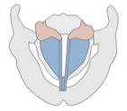
Breathy voice
a.k.a “murmur”
Vocal folds are partially open letting air pass through but still vibrating
English: differentiates voices, not sounds
Hindi (e.g.): differentiates sounds
[bal]
hair
[b̤al]
forehead

Slide 24
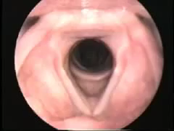
https://www.youtube.com/watch?v=9cKnUFZjs8k

Slide 25
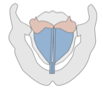
Creaky voice
Vocal folds are compressed and slack
Vibrate (open and close) slowly and irregularly
Lower pitch
English: often used to signal end of utterance, socially evaluated, but doesn’t distinguish sounds
Other languages: distinguishes sounds
E.g. Hausa (Nigeria):
/ja:/ ‘he’ vs. /j̰a:/ ‘daughter’

Slide 26
Speech production
Air supply sets air in motion (e.g. lungs)
A sound source (e.g. larynx), modulates airflow via vocal folds
Filters modify the sound:
Pharynx, oral cavity, nasal cavity
Together called vocal tract

